Slide 1
Virtual Doctor
Presented by:
Tejash Shrestha
1NT14CS206
Guided by:
Dr. MN Thippeswamy
HOD & Professor CSE
01/12/2015
Notes:
This template can be used as a starter file for presenting training materials in a group setting.
Sections
Right-click on a slide to add sections. Sections can help to organize your slides or facilitate collaboration between multiple authors.
Notes
Use the Notes section for delivery notes or to provide additional details for the audience. View these notes in Presentation View during your presentation.
Keep in mind the font size (important for accessibility, visibility, videotaping, and online production)
Coordinated colors
Pay particular attention to the graphs, charts, and text boxes.
Consider that attendees will print in black and white or grayscale. Run a test print to make sure your colors work when printed in pure black and white and grayscale.
Graphics, tables, and graphs
Keep it simple: If possible, use consistent, non-distracting styles and colors.
Label all graphs and tables.

Slide 2

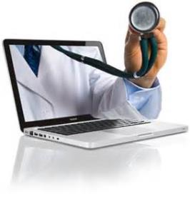
Welcome

Slide 3
Introduction
" VIRTUAL DOCTOR" - a faster way to detect health problems .
A better healthcare at your fingertips.
The software developed detects the disease affected to the user .
Prescribes medicines and gives precautions to treat the disease.
The code is a prototype of an actual virtual doctor software.
The result given by this software is not completely reliable.
Notes:
Give a brief overview of the presentation. Describe the major focus of the presentation and why it is important.
Introduce each of the major topics.
To provide a road map for the audience, you can repeat this Overview slide throughout the presentation, highlighting the particular topic you will discuss next.

Slide 4
SYSTEM ANALYSIS EXISTING SYSTEM PROPOSED SYSTEM SCOPE OF THE PROJECT AIM OF THE PROJECT PROJECT MODULES
Notes:
Use a section header for each of the topics, so there is a clear transition to the audience.

Slide 5
SYSTEM ANALYSIS "VIRTUAL DOCTOR" system provides an improved, faster and instant approach of diagnosing and prescribing medicines to different diseases. Virtual doctor visits are rapidly gaining popularity these days as more health insurers offer telemedicine services to help cut costs. Studies have shown that virtual care may effectively use to treat common problems and infections.
1
2
PROPOSED SYSTEM
EXISTING SYSTEM
Notes:
This is another option for an Overview slide.

Slide 6
Existing System
Currently there are only limited facilities available such as meeting the doctor personally where the time consumed will be more.
In present days e-consultation is also available to help the patients.
Notes:
What will the audience be able to do after this training is complete? Briefly describe each objective how the audience will benefit from this presentation.

Slide 7
Proposed System
SCOPE OF THE PROJECT
The patients are able to detect the diseases by themselves.
Find solution to their health problems without consulting a doctor.
Eliminates the disadvantage of delayed care on the health problem.
Provides consultancy service round the clock.
Eliminates appointment system.
The software can be updated to include new medicines.
Notes:
What will the audience be able to do after this training is complete? Briefly describe each objective how the audience will benefit from this presentation.

Slide 8
SYSTEM FEATURES
Notes:
Use a section header for each of the topics, so there is a clear transition to the audience.

Slide 9
AIM OF THE PROJECT
Provide an improved, faster and instant approach of diagnosing and prescribing medicines to different diseases.
The patient is himself able to know the causes of his disease.
Basic precautions to be taken to get rid of the disease
Some of the medicines that can be prescribed for the disease detected.
Notes:
What will the audience be able to do after this training is complete? Briefly describe each objective how the audience will benefit from this presentation.

Slide 10
SYSTEM ARCHITECTURE
Notes:
Use a section header for each of the topics, so there is a clear transition to the audience.

Slide 11
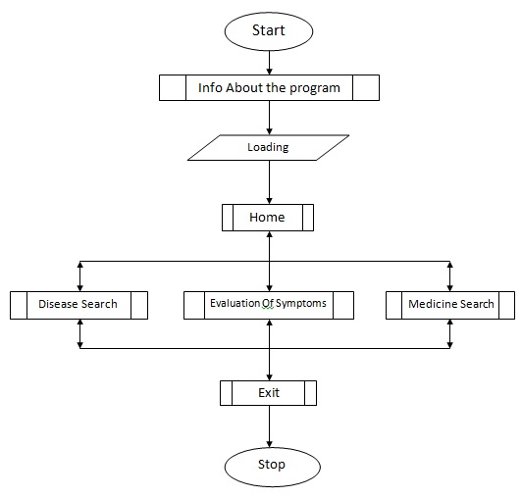
System Features(flowchart)
Notes:
What will the audience be able to do after this training is complete? Briefly describe each objective how the audience will benefit from this presentation.

Slide 12
PROJECT MODULES
Notes:
Use a section header for each of the topics, so there is a clear transition to the audience.

Slide 13
PROJECT MODULES
The project has been slashed into many small modules to run effectively, easy to understand and debug. Some important modules used in the project are:
Home module
Disease Search module
Symptoms evaluation module
Medicines search module
Exit module
Notes:
What will the audience be able to do after this training is complete? Briefly describe each objective how the audience will benefit from this presentation.

Slide 14
Home Module
This module gives the information about the different tabs that are being used in the program.
The user can make use of this home module to know about the tabs which he or she has to make use.
In the program we have made use of tabs like disease search, evaluation of symptoms and medicine.
This module gives a overview of all other tabs.
Notes:
What will the audience be able to do after this training is complete? Briefly describe each objective how the audience will benefit from this presentation.

Slide 15
Disease Search Module
To have glance about the known disease or infection.
The user has to give the disease name that he is suffering from and he will be able to know about the symptoms of that disease and will be even able to know about some of the precautions that has to followed to recover.
Notes:
What will the audience be able to do after this training is complete? Briefly describe each objective how the audience will benefit from this presentation.

Slide 16
Symptom Evaluation Module
If the user is having certain symptoms and if he is not aware of the disease that he is suffering from, the user can make use of this module and know about his disease.
What the user has to make is, he has to give his symptom and he will be able to know about the disease.
Notes:
What will the audience be able to do after this training is complete? Briefly describe each objective how the audience will benefit from this presentation.

Slide 17
Medicine Search Module
If the user is aware of his disease already he can get to know about some of the medicines that can be prescribed for the disease detected.
Only some major medicines which can be prescribed are given in the disease module which the user can make use of.
Notes:
What will the audience be able to do after this training is complete? Briefly describe each objective how the audience will benefit from this presentation.

Slide 18
Exit Module
This module has the information about the programmers.
It has the names of the programmers and the way out of the program.
Notes:
What will the audience be able to do after this training is complete? Briefly describe each objective how the audience will benefit from this presentation.

Slide 19
Results & Applications of Project
Notes:
Use a section header for each of the topics, so there is a clear transition to the audience.

Slide 20
Results
The result obtained is a complete package of program which is able to detect disease and prescribe medicines with adequate precautions.
Other words will be explained with the demo of project.
Notes:
What will the audience be able to do after this training is complete? Briefly describe each objective how the audience will benefit from this presentation.

Slide 21
Application Of Project
This application can be used anywhere and anytime.
This gives a friendly response for the disease present in its database.
Symptoms, Precautions and Medicines of disease or infection are known without a visit to doctor.
Notes:
What will the audience be able to do after this training is complete? Briefly describe each objective how the audience will benefit from this presentation.

Slide 22
Software Used
To design this program we have used Turbo C. Some graphic library functions and standard header files are used for building of the program.
Mouse is used to make it more interactive and the visual presentation is managed in simpler way, so that it is accessible to all people.
Notes:
What will the audience be able to do after this training is complete? Briefly describe each objective how the audience will benefit from this presentation.

Slide 23
Conclusion & References
Notes:
Use a section header for each of the topics, so there is a clear transition to the audience.

Slide 24
Conclusion
Instant care can be done through this software to get the necessary precautions to be taken so that the patient stays safe before serious action are taken.
The patients need not run to the doctor for suggestions in case of minor health problems like common cold, headache etc..
This project helped us a lot in enhancing our knowledge in programming
Notes:
What will the audience be able to do after this training is complete? Briefly describe each objective how the audience will benefit from this presentation.

Slide 25
References
The information in the report provided was derived from the following sources:
www.google.com
http://www.virtualdoctors.org/#home
[1] THE VIRTUAL DOCTORS
Notes:
What will the audience be able to do after this training is complete? Briefly describe each objective how the audience will benefit from this presentation.

Slide 26
Questions?

Slide 27
Thank You.

